Slide 1
MALL CUSTOMER SEGMENTATION
CLUSTER ANALYSIS & STATISTICS ANALYSIS
Presented By: Timileyin Anthony

Slide 2
Introduction
Data Sources
Data Preprocessing
Exploratory Data Analysis (EDA)
Univariate Clustering Analysis
Bivariate Clustering Analysis
Multivariate Clustering Analysis
Statistics Analysis
Recommendations
CONTENT

Slide 3
Introduction
Welcome to our Customer Segmentation and Analysis project. In today’s competitive market, understanding customer behavior is crucial for businesses to tailor their strategies effectively. This project leverages advanced data analysis techniques to segment customers based on demographic and spending patterns, providing actionable insights to enhance marketing strategies and boost customer loyalty.
Through a methodology approach, we’ve cleaned and preprocessed the data, explored key relationships, performed clustering to identify distinct customer groups, and conducted statistical tests to validate our findings. Our goal is to offer clear and practical recommendations that can help businesses attract, engage, and retain customers more efficiently.

Slide 4
Data Sources
The data used in this project was sourced from the Kaggle website, a popular platform for data science and machine learning datasets. The dataset contains information on mall customers, including demographic details and spending behavior.
Dataset Details
Source: Kaggle
Link to Dataset: https://www.kaggle.com/datasets/vjchoudhary7/customer-segmentation-tutorial-in-python
Description: The dataset includes the following columns:
CustomerID: Unique identifier for each customer.
Gender: Gender of the customer (Male/Female).
Age: Age of the customer.
Annual Income (k$): Annual income of the customer in thousand dollars.
Spending Score (1-100): Score assigned to the customer based on their spending behavior.

Slide 5
Data Preprocessing
In this project, I applied several data preprocessing steps to prepare the dataset for analysis
Age Grouping: We categorized the age of customers into different groups (Youth, Adult, Old) using list comprehensions.
Label Encoding: To convert the gender column into a numeric format.
Standard Scaler: I applied StandardScaler to normalize the data by removing the mean and scaling to unit variance.
Principal Component Analysis (PCA): PCA was used to reduce the dimensionality of the dataset.
Eblow: This graph finds the optimal K value in clustering
K-means: I performed K-means clustering to segment customers based on their spending behavior, age, and income levels.
Univariate Analysis: I conducted a clustering analysis on individual variables (Annual Income and Spending Score) to understand their distribution and identify distinct segments.
Bivariate Analysis: Clustering was performed to pair Annual Income and Spending Scores to analyze the relationship between them and identify customer segments.
Multivariate Clustering: We extended the clustering analysis to multiple variables, and all available features to identify customer segments. This involved using PCA to simplify the feature space before applying Kmeans clustering.
Statistical Analysis: I conducted a statistical analysis to examine the relationship

Slide 6
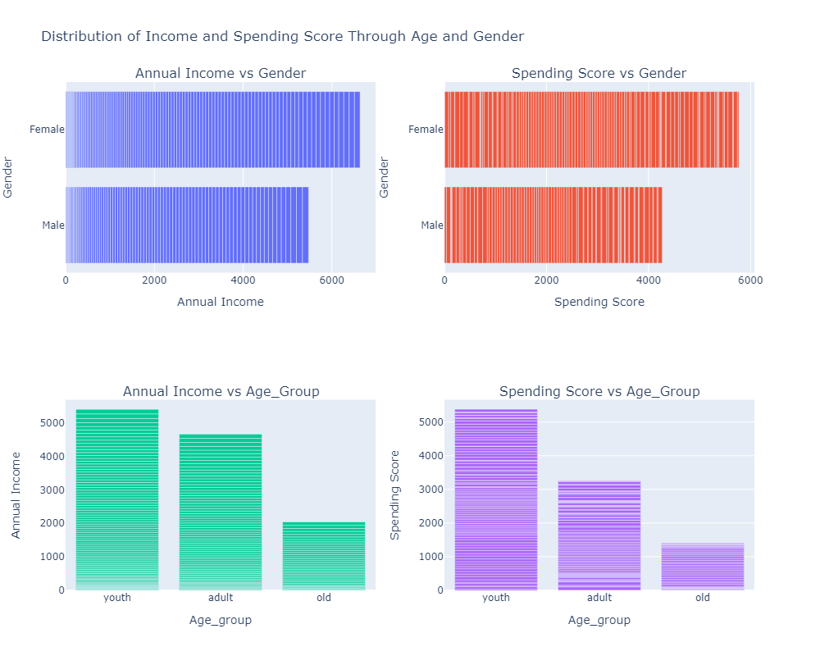
EXPLORATORY DATA ANALYSIS (EDA)
Interpretation
Women earn and spend more money annually compared to men.
Young people earn and spend more compared to adults and older people, who have the lowest earnings and spending scores

Slide 7
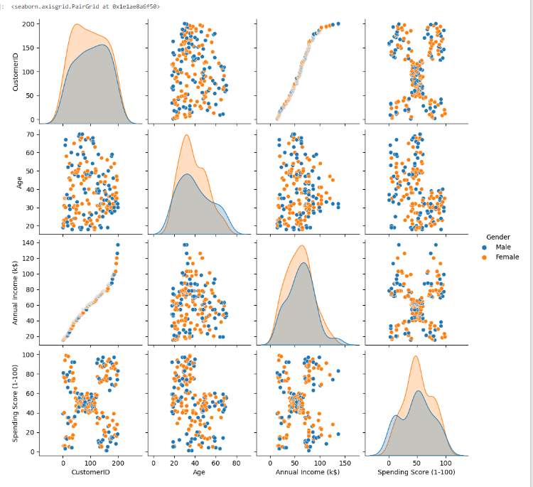
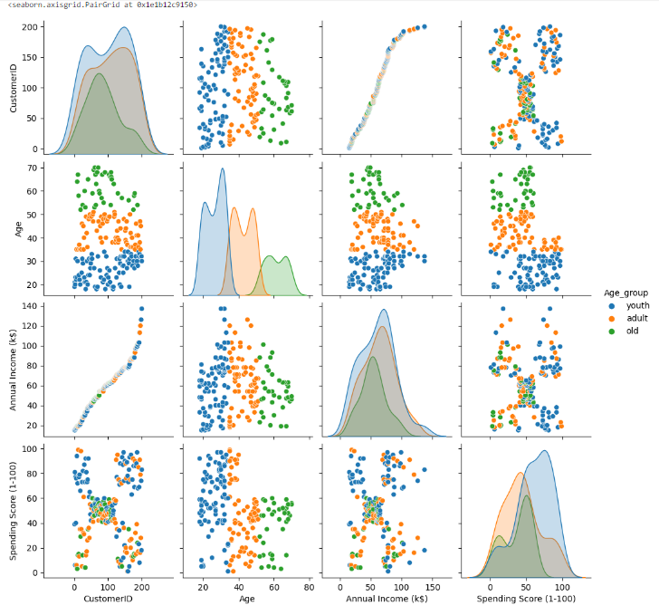
EXPLORATORY DATA ANALYSIS (EDA)
The Different Relationships of Gender and Age_Group in the Data
Gender
Age_Group

Slide 8
Univariate Clustering Analysis

Slide 9
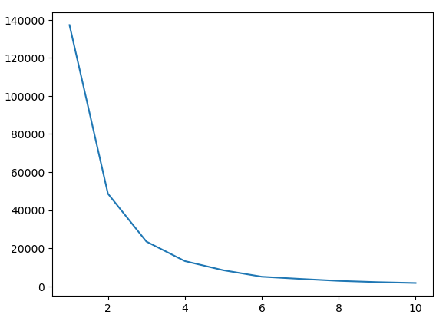
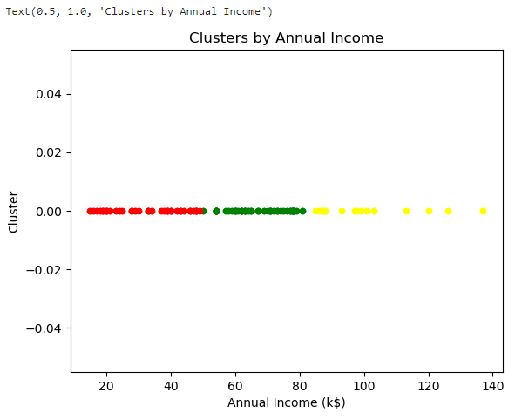
Annual Income
Interpretation of the eblow graph and findings
The elbow point on the graph occurred at 3 clusters
This suggests that dividing the data into 3 clusters
There are three distinct groups of customers based on their annual income levels

Slide 10
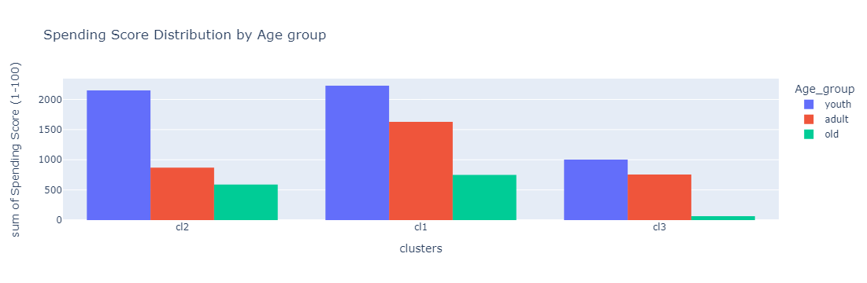
Annual Income Clusters on Spending Score by Age Group
Cluster Interpretation
In cl2 youth age group has the highest number of customers, followed by the adult age group and then the old age group
cl1 also has a large number of customers in the youth age group, followed by the adult age group and then the old age group
In cl3 has the lowest number of customers overall
Recommendations
For Cluster 2 and Cluster 1, Tailor marketing strategies and promotions that appeal to each age group's spending because they have a meaningful number of customers across all age groups

Slide 11
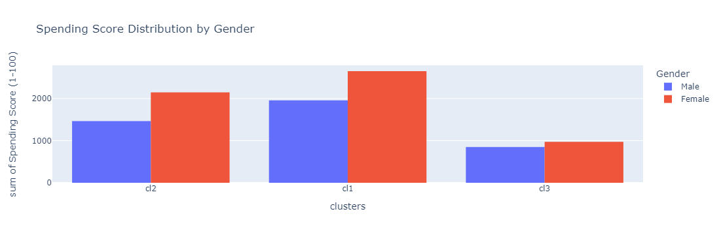
Annual Income Clusters on Spending Score by Gender
Cluster Interpretation
In all clusters, there are more female customers than male customers
Spending scores vary, but the trend of females being more general remains consistent
Recommendations
Develop marketing campaigns that are particularly appealing to female customers
Create promotions and offers that are tailored to both genders

Slide 12
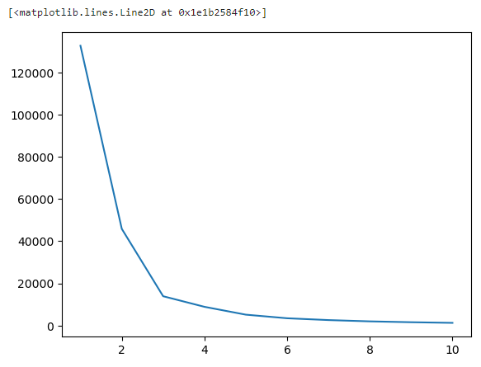
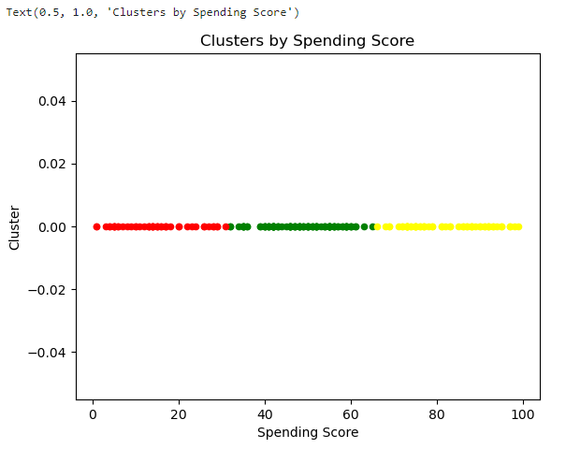
Spending Score
Interpretation of the eblow graph and findings
The elbow point on the graph occurred at 3 clusters
This suggests that dividing the data into 3 clusters
There are three distinct groups of customers based on their Spending Score

Slide 13
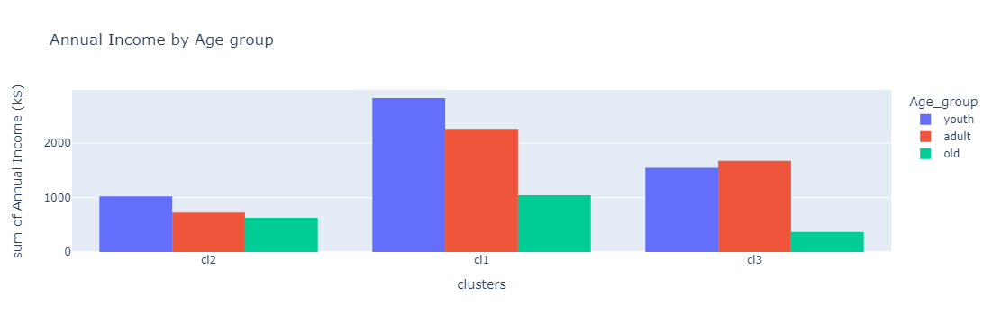
Spending Scores Clusters on Annual Income by Age Group
Interpretation
Cluster 2 has the least number of customers in each age group
Cluster 1 has the largest number of customers across all age groups
Cluster 3 has a higher number of adults compared to youths and a smaller number of older customers.
Recommendations
Focus on niche marketing strategies that appeal to each age group in cluster 2
In cluster 1, Implement loyalty programs and incentives for young customers to keep them engaged and increase their lifetime value.
In cluster 3 consider promoting products and services that cater to mid_life needs and Target older customers with specialized offers to increase their engagement and spending

Slide 14
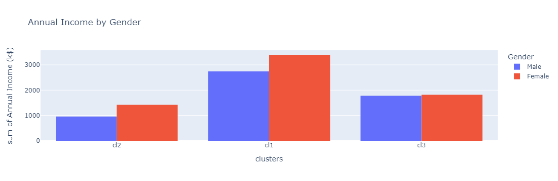
Spending Scores Clusters on Annual Income by Age Group
Interpretation
Cluster 1 Indicates a higher income group.
Cluster 2 Has the fewest number of customers, with more females than males.
Cluster 3 Has a nearly equal number of males and females
Recommendations
Cluster 1, Focus on high-income products and premium services and Create gender-specific marketing campaigns to appeal to both males and females.
Cluster 2, Develop targeted offers to attract more male customers and Promote mid-range products that might appeal to a broader audience.
Cluster 3, Design inclusive marketing strategies that appeal equally to both males and females. and Offer a variety of products catering to different preferences

Slide 15
Bivariate Clustering Analysis

Slide 16
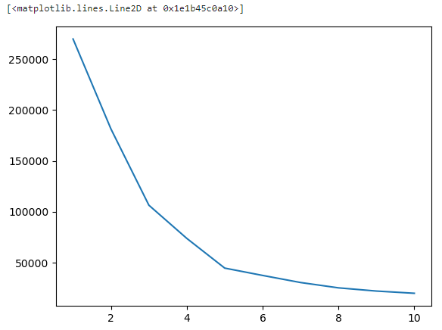
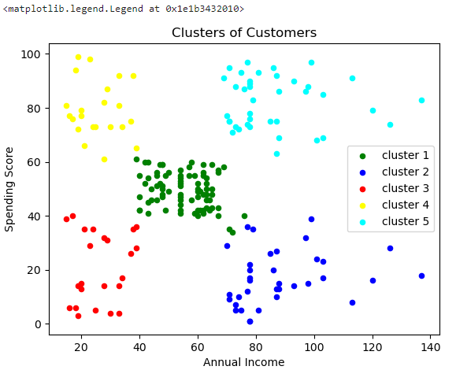
Annual Income (k$) vs Spending Score (1-100)
Interpretation of the eblow graph and findings
This elbow shows 5 clusters.
5 clusters is the optimal number for segmenting the data
Divide the customers into 5 distinct groups

Slide 17
Annual Income (k$) vs Spending Score (1-100)
Recommendations
Cluster 1 = Offer mid-range products and regular promotions to encourage consistent spending.
Cluster 2 = Implement campaigns that highlight the value and benefits of higher-priced products
Cluster 3 = Focus on budget-friendly options and frequent discounts
Cluster 4 = Provide incentives for frequent purchases to keep them engaged.
Cluster 5 = Offer premium and exclusive products, personalized services, and VIP experiences.
Interpretation
Cluster 1 = Customers with moderate income and moderate spending scores
Cluster 2 = Customers with high income but low spending scores
Cluster 3 = Customers with low income and low spending scores
Cluster 4 = Customers with low income but high spending scores
Cluster 5 = Customers with high income and high spending scores

Slide 18
Multivariate Clustering Analysis

Slide 19
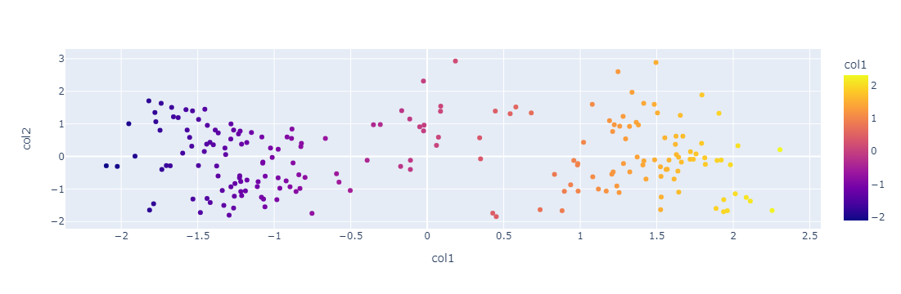
Data Modeling
After Standardize
Reduce the column to two using PCA

Slide 20
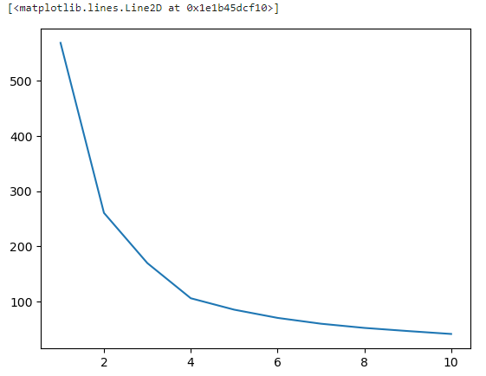
Multivariate Eblow Analysis
Interpretation of the eblow graph and findings
The number of clusters shows an elbow at 4 clusters
Indicates that 4 clusters is the optimal number for segmenting the data

Slide 21
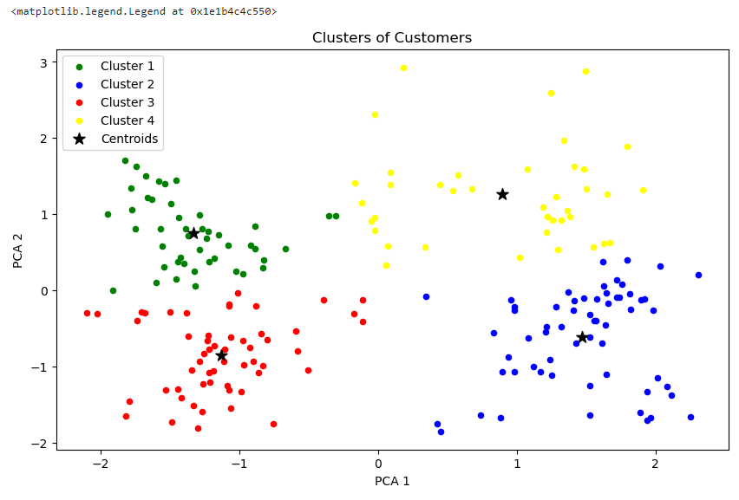
Multivariate Cluster Chart

Slide 22
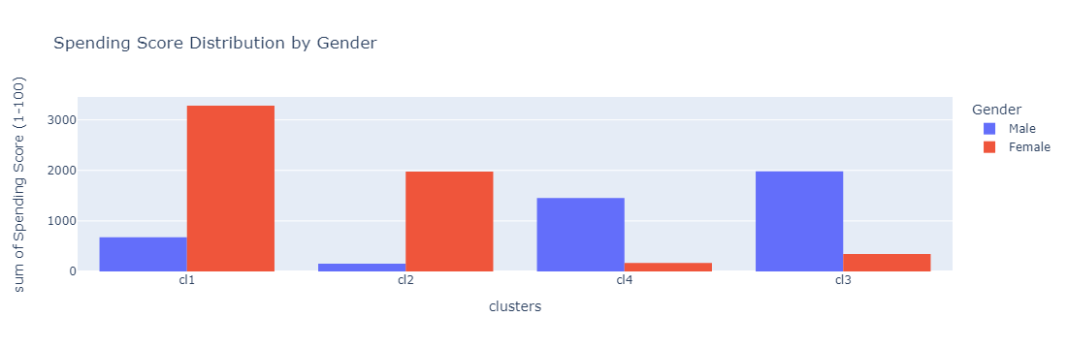
Multivariate Cluster Analysis on Spending Score by Gender
Interpretation
Cluster 1 and Cluster 2, Have a significantly higher number of female customers compared to males.
Cluster 3 and Cluster 4, Have a significantly higher number of male customers compared to females.
Recommendations
In Cluster 1 and Cluster 2, Focus marketing campaigns and promotions on products and services that appeal to female customers.
For Cluster 3 and Cluster 4, Develop marketing strategies that target male customers, offering products and services that cater to their interests.

Slide 23
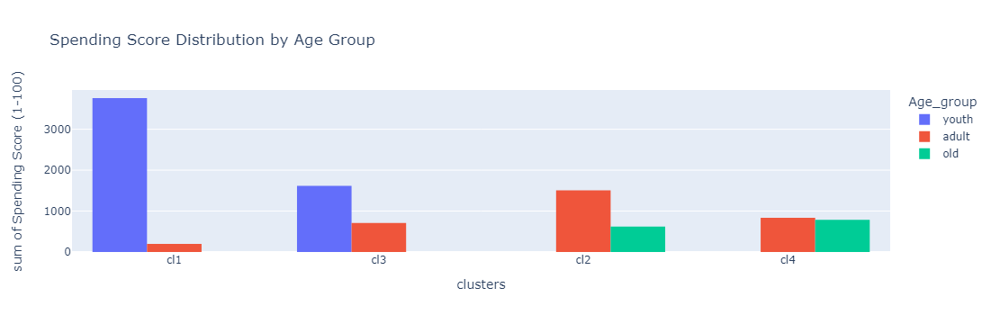
Multivariate Cluster Analysis on Spending Score by Age Group
Interpretation
Cluster 1 is Dominated by youth customers, indicating a younger with high spending scores.
Cluster 3 Mostly youth but with a notable adult presence.
Cluster 2 Adults with a significant number of older customers, indicating mature spending habits.
Cluster 4 Balanced between adults and older customers, suggesting stable and mature spending patterns.
Recommendations
Cluster 1 Focus marketing efforts on products and services that appeal to young customers.
Cluster 3 Develop marketing strategies that appeal to both youth and adults.
Cluster 2 Target marketing towards adults and older customers.
Cluster 4 Create campaigns that appeal to both adults and older customers.

Slide 24
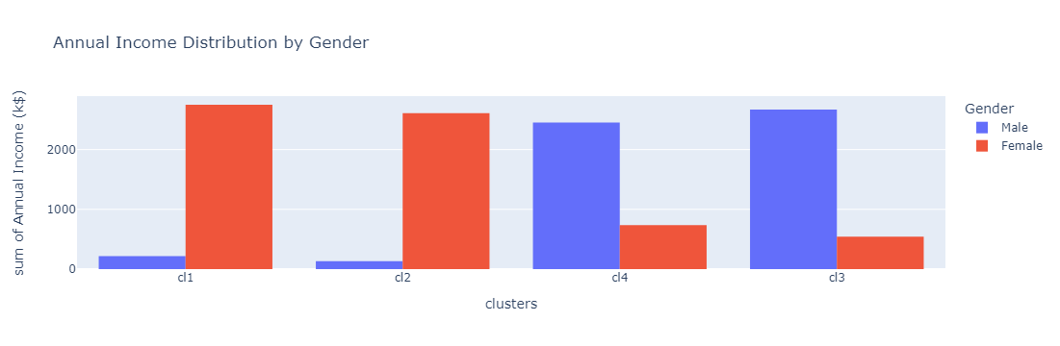
Multivariate Cluster Analysis on Annual Income by Gender
Interpretation
Cluster 1 and Cluster 2 are dominated by female customers with high annual incomes
Cluster 3 and Cluster 4 have a higher number of male customers with high annual incomes.
Recommendations
Cluster 1 and Cluster 2, Focus marketing on high-income female customers. And Promote luxury products, exclusive offers, and premium services that appeal to affluent women.
Cluster 3 and Cluster 4, Target high-income male customers. And Highlight high-end products and services that cater to their interests.

Slide 25
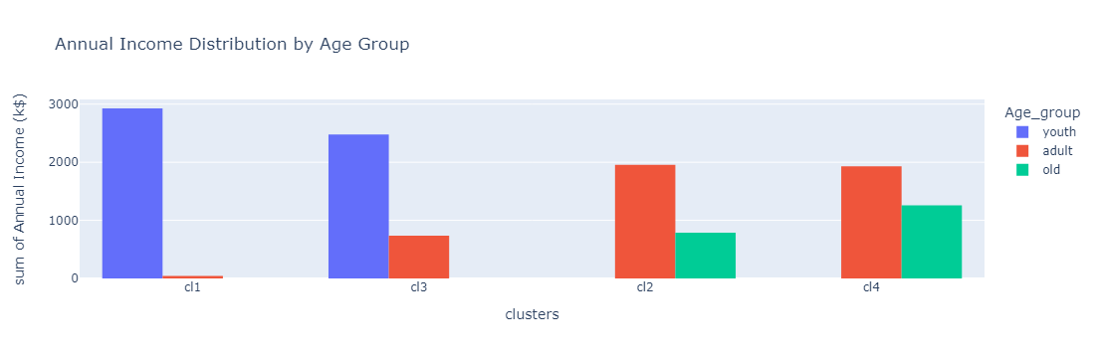
Multivariate Cluster Analysis on Annual Income by Age Group
Interpretation
Cluster 1 and Cluster 3 are dominated by youth customers with higher annual incomes.
Cluster 2 and Cluster 4 have a mix of adult and older customers with moderate to high annual incomes.
Recommendations
Cluster 1 and Cluster 3 Target high-income youth customers and Promote trendy products
Cluster 2 and Cluster 4 Develop marketing strategies for both adult and older customers and Offer a range of products and services that cater to different age preferences and lifestyles.

Slide 26
Statistics Analysis

Slide 27
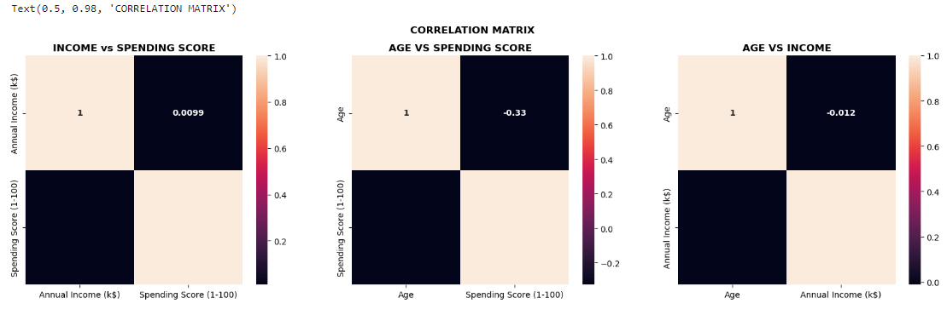
Correlation Matrix
Interpretation of Correlation Results
Annual Income vs. Spending Score
Correlation Coefficient: 0.009903
The correlation is very close to zero.
There is no significant linear relationship.
Customers with different income levels have similar spending scores.
Age vs. Spending Score
Correlation Coefficient:0.327227
These indicate a weak negative relationship.
As age decreases, the spending score decreases weakly.
Age vs. Annual Income:
Correlation Coefficient: -0.012398
The correlation is very close to zero but negative.
There is no significant linear relationship between age and annual income.
Customers of different ages have similar annual incomes

Slide 28
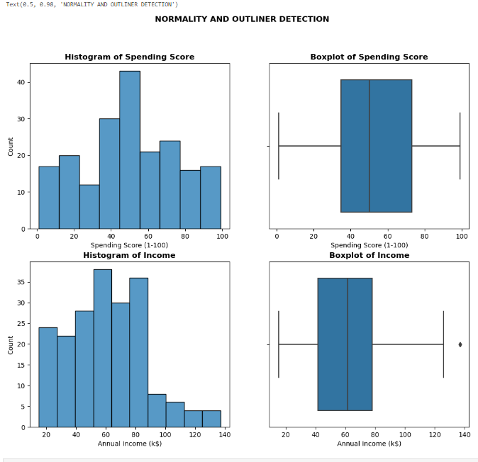
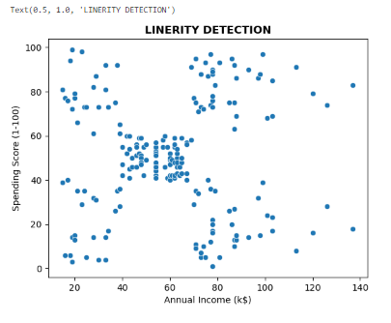
Check assumptions of correlation before performing the Hypothesis Test
Interpretation of Assumption Checking
After checking the assumptions for correlation, we found that only the continuous variable assumption is met

Slide 29
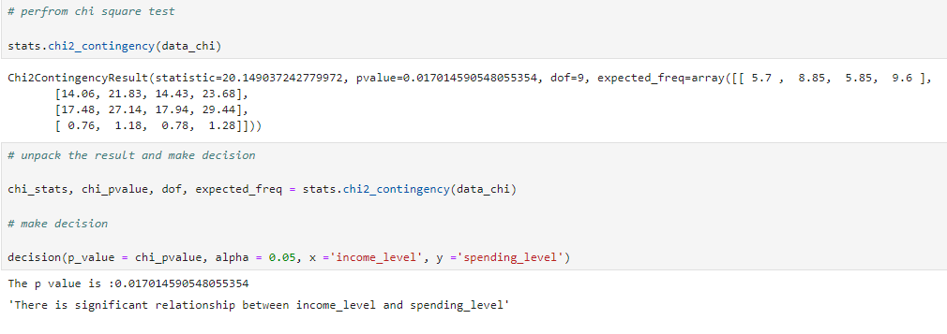
CHI SQUARE TEST OF ASSOCIATION
Test of Annual Income and Spending Scores
Chi-Square Test Finding
The p-value of 0.017 means there is a significant relationship between income levels and spending levels
This finding is statistically significant
This indicates that how much someone earns is associated with how much they spend

Slide 30
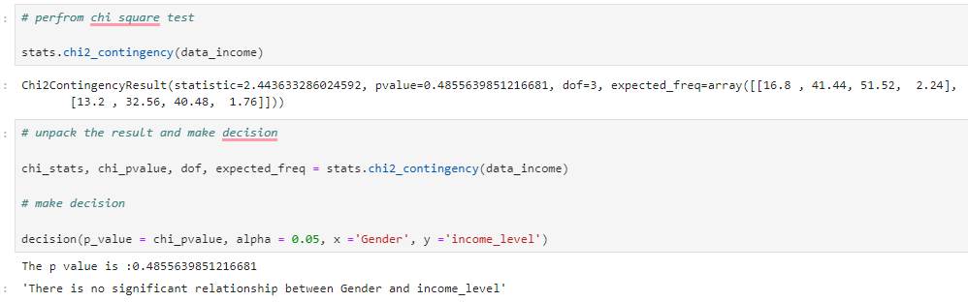
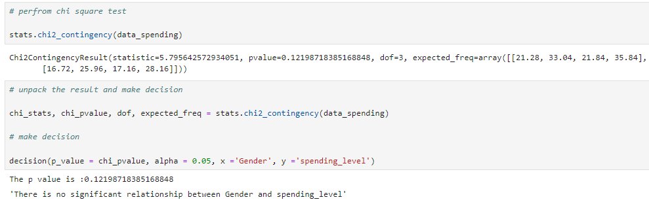
Gender contributes to income level and spending level
Income level
spending level
Finding Interpretation
The p-value of 0.485 means there is no significant relationship between gender and income level.
This indicates that gender alone is not a strong predictor of income level
Finding Interpretation
The p-value of 0.122 indicates there is no significant relationship between gender and spending level.
This means gender is not a decisive factor in determining how much someone spends.
These findings indicate that spending habits are not strongly influenced by gender alone

Slide 31
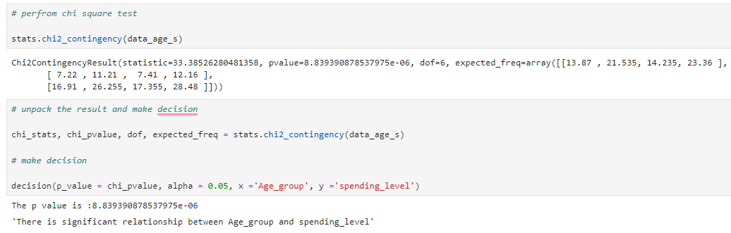
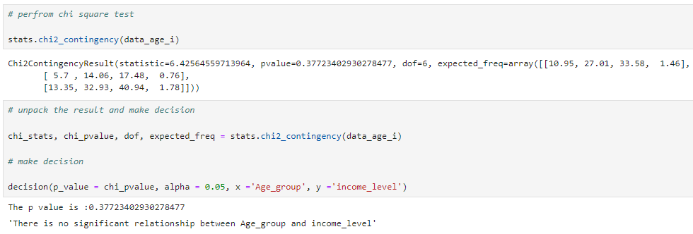
Age Group contributes to income level and spending level
Spending level
Income level
Finding interpretation
The p-value (8.84e-06) indicates a significant relationship between age group and spending level.
These data strongly mean that a person's age group is closely linked to how much they spend.
This finding is statistically significant, That different age groups exhibit distinct spending behaviors.
Finding interpretation
The p-value of 0.377 suggests that there is no significant relationship between age group and income level.
These data do not show a meaningful connection between someone's age group and their income level.
This finding indicates that age group alone is not a strong predictor of income level

Slide 32
Recommendations
Targeted Marketing
Develop targeted marketing strategies based on age groups rather than gender or income alone.
Age group has a significant impact on spending behavior
Tailoring campaigns to different age demographics can lead to more effective results.
Customer Segmentation
Use clustering techniques to group customers based on their spending habits and preferences.
Create personalized experiences and promotions that resonate with each customer segment.
Product Placement
Place products strategically based on spending patterns.
For example, high-spending age groups could be targeted with premium products.
while moderate spenders might respond well to value propositions.
Promotional Campaigns
Design promotions and offers that appeal to specific age groups.
Consider offering discounts or incentives that align with the spending behavior of each age demographic.
Continuous Monitoring
Continuously monitor customer behavior and adjust strategies accordingly.

Slide 33
THANK YOU

